Slide 1

Capabilities | Platforms | Approach | Contact
achieve breakthrough results
Market Optimizing Solutions
Platforms to scale margin and increase revenue velocity
Companies | Business Lines | Programs | New Ventures | Whole Markets

Slide 2
Capabilities | Optimizations-as-a-Service
Zero-Trust Controls
Process Transformations
Event-Rule Models
Dynamic Configurations
Accountable Permissions/Procedures
Compliance Enforcements
Streamlinings
User Proofings
Functional Automations
Nuanced Workflows
Market/Service Expansions
Expectation Shapings
Loss Preventions
Customer Integrations
Value Rewirings
Market Steering Innovations
Systems Integrations
KPIs/Analytics

Slide 3
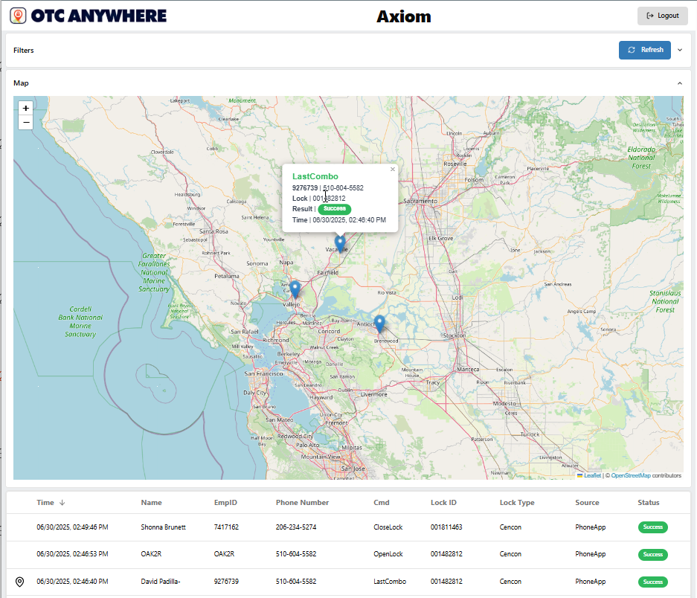

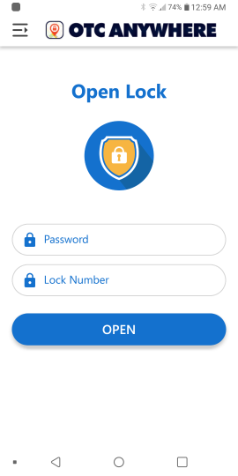

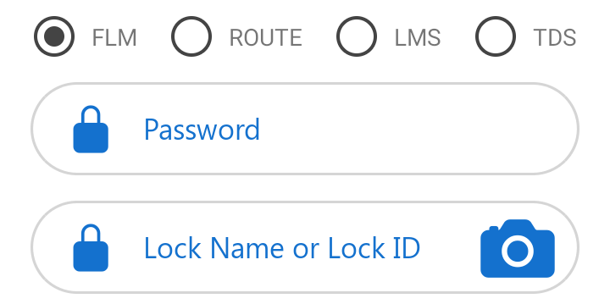


Breakthroughs Delivered | Market Optimization - ATM Access Management
Visit Site
Secured ATM Lock Access Automation
Cross-Platform (Kaba, S&G, Intergard)
500K+/mo Secured ATM Opens/Closes
Secured Self Dispatch
Schedule Demo

Slide 4
Challenge:
Securely automate permitted ATM lock access requests directly from authorized field technicians and cash loaders
Target:
Reduce manpower requirements to staff dispatch support operations while preserving fully security and auditability
Outcome:
Cross-ATM-lock-system-platform offloading 95%+ of routine daily manual dispatching costs

Slide 5
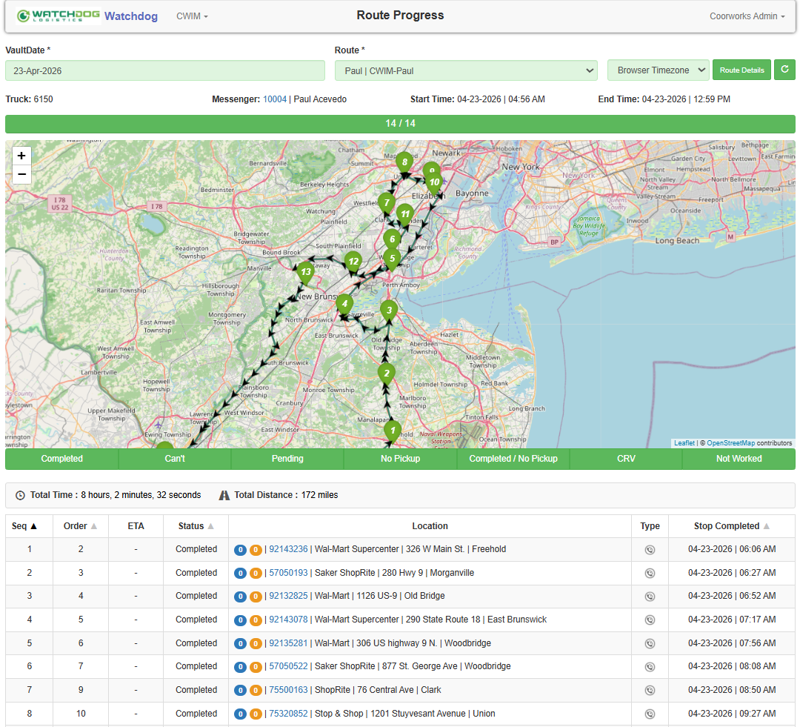

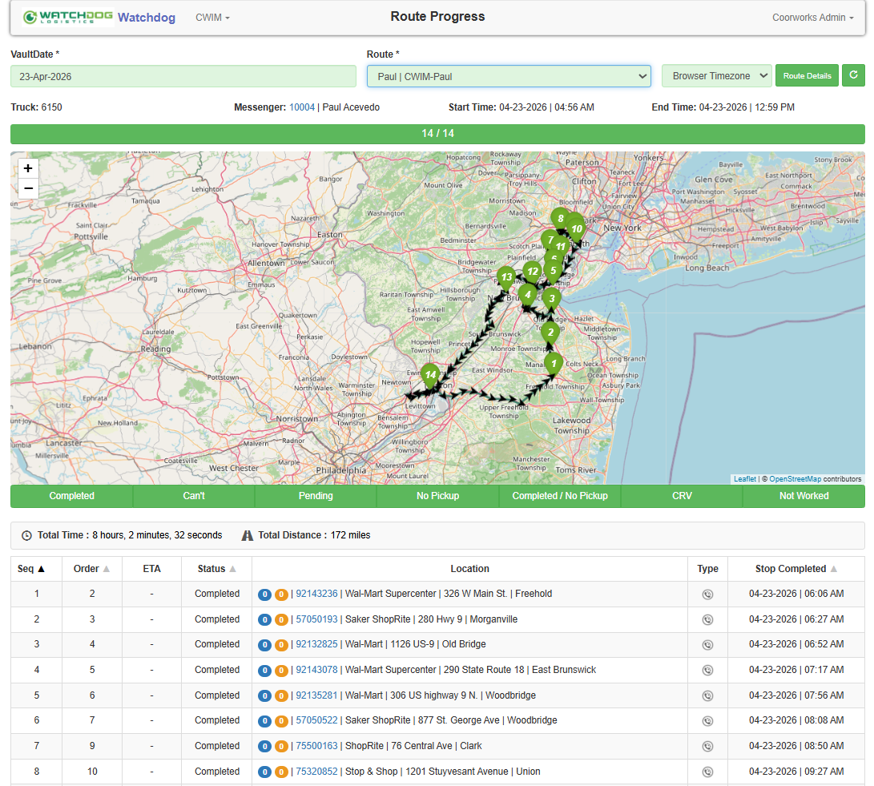
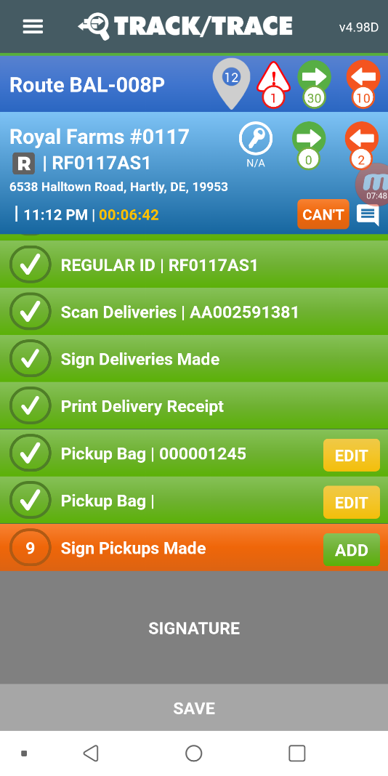



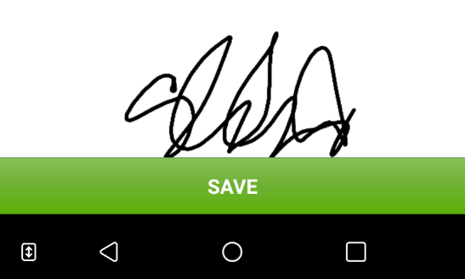
Breakthroughs Delivered | Company Optimization – CIT/ATM/FLM Cash Operations/Logistics
Main Branch
Visit Site
Zero-Trust CIT/ATM/Vault/FLM Operations
$3Bn+/mo Secured Cash Processing/Transport
Schedule Demo
Workflow Enforcement

Slide 6
Challenge:
Replace a degrading cash logistics platform with a more adaptive, streamlined, and auditable operations foundation leveraging contemporary technologies for a 24x7 high-volume cash processing/transportation provider.
Target:
Provide a simplified, multi-lingual, multi-currency cash operations platform with centralized control enforcements across all aspects of the operations model (vaults, branches, trucks, routes, field users)
Outcome:
Reduced resource onboarding times, increased operating consistency, and centralized auditing of all operational details across billions in monthly cash movements.

Slide 7
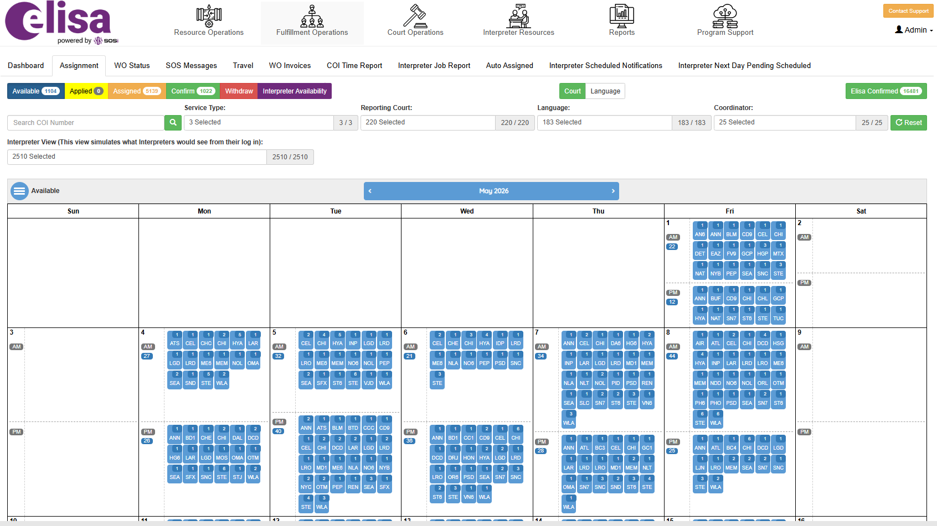
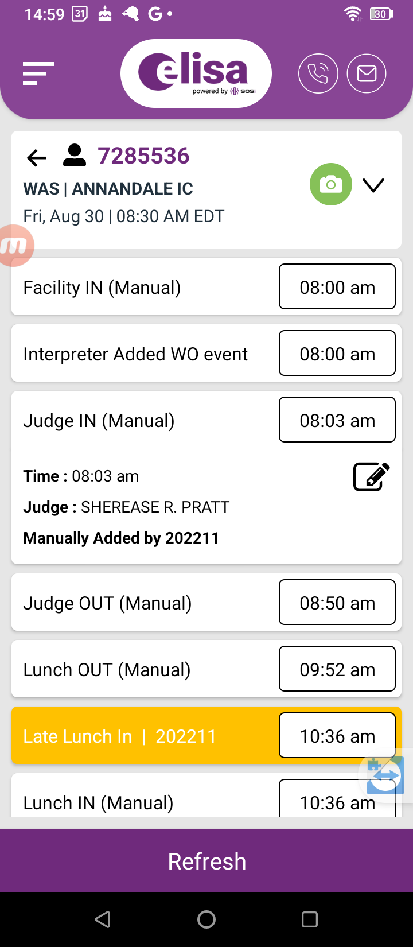

Breakthroughs Delivered | Program Optimization – Contracted Services Fulfillment + Compliance Mgmt
US Immigration Court Services
Contracted Interpreter Fulfillment +Compliance
25k+/mo DOJ/EOIR Interpretation Service Orders
Government Compliance

Slide 8
Challenge:
Provide an uber-like open marketplace for DOJ approved court interpretation contractors to self-select appropriate case loads within defined operating rules and contractor rate preferences
Target:
Reduce resources/costs associated with manually coordinating court work order assignments with aligned contract resources, to increase contractor compliance with governmental work performance requirements, and to avoid government penalties for underdelivering minimum work order fulfillment rates
Outcome:
82%+ automated fulfillment of approximately 20-25k/month DOJ approved interpretation service work orders and massive reduction of internal processing requirements to invoice services

Slide 9
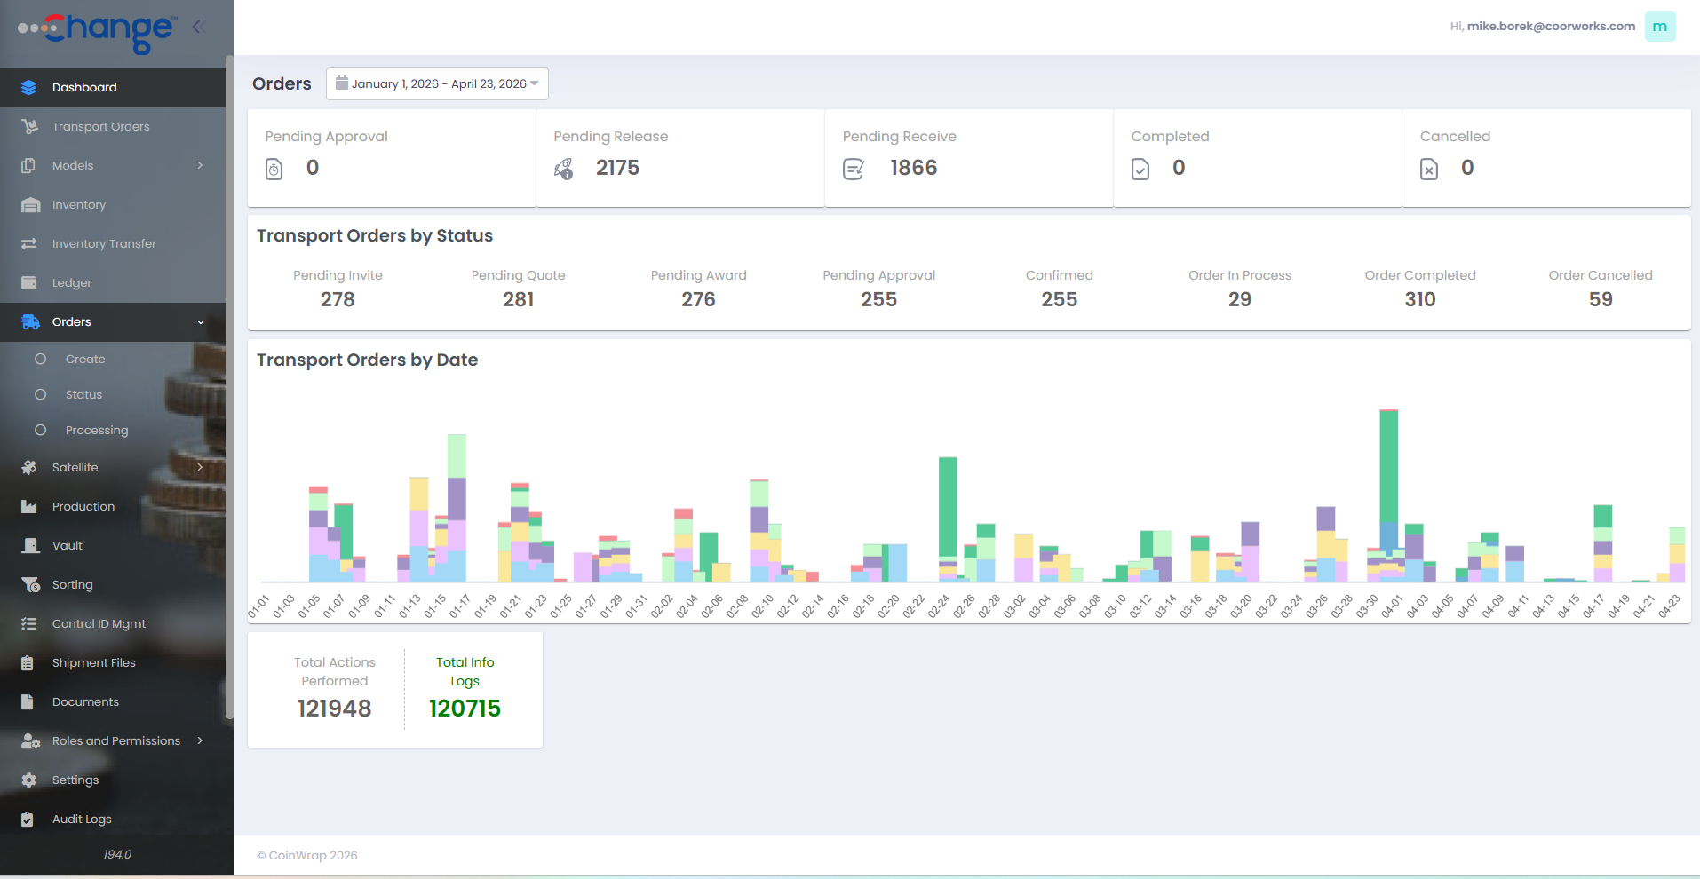

Breakthroughs Delivered | Business Optimization – Coin Currency Order Processing
Coin Currency Processing Management
$100M+/mo Coin Processing Order Flows
Revenue Velocity

Slide 10
Challenge:
Digitally transform internal operations for national coin processing and servicing operation
Target:
Expedite coin packaging turns and increase overall business velocity
Outcome:
$100M+/mo in fully-auditable coin packaging orders, creation of new business line for transportation coordination, increased billing accuracy and speed

Slide 11
Approach
Adaptive
Budget
Timeframe
Goal
Budget
Budget-Driven Solution Engineering
Agile Resourcing
Realistic AI Deployment
Timeframe
Platform Accelerations
Iterative Functional Development
Direct Stakeholder Participation
Goal
Innovation Validation
Collaborative Outcome Targeting
Creative IP Arrangements

Slide 12
Contact
CoorWorks
1069 W Broad Street #813
Falls Church, VA 22046
703-200-6225
What’s Next?
Name
Email
Comment

Slide 13
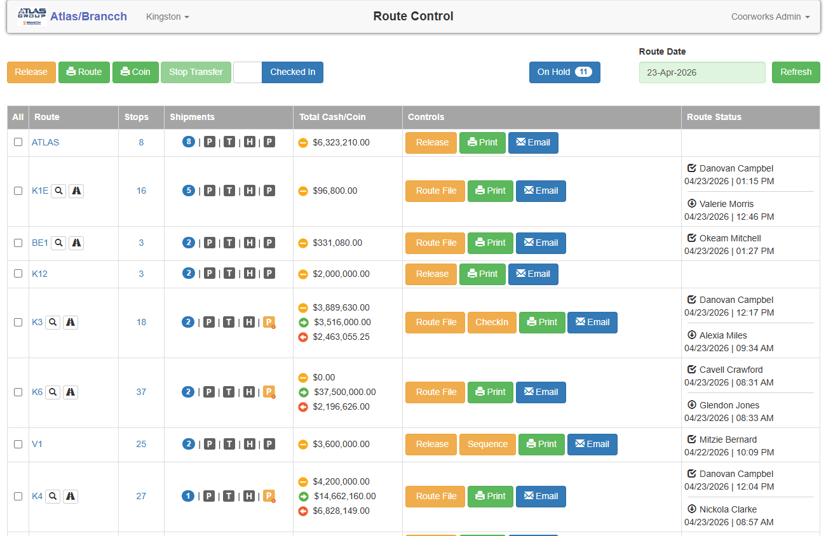
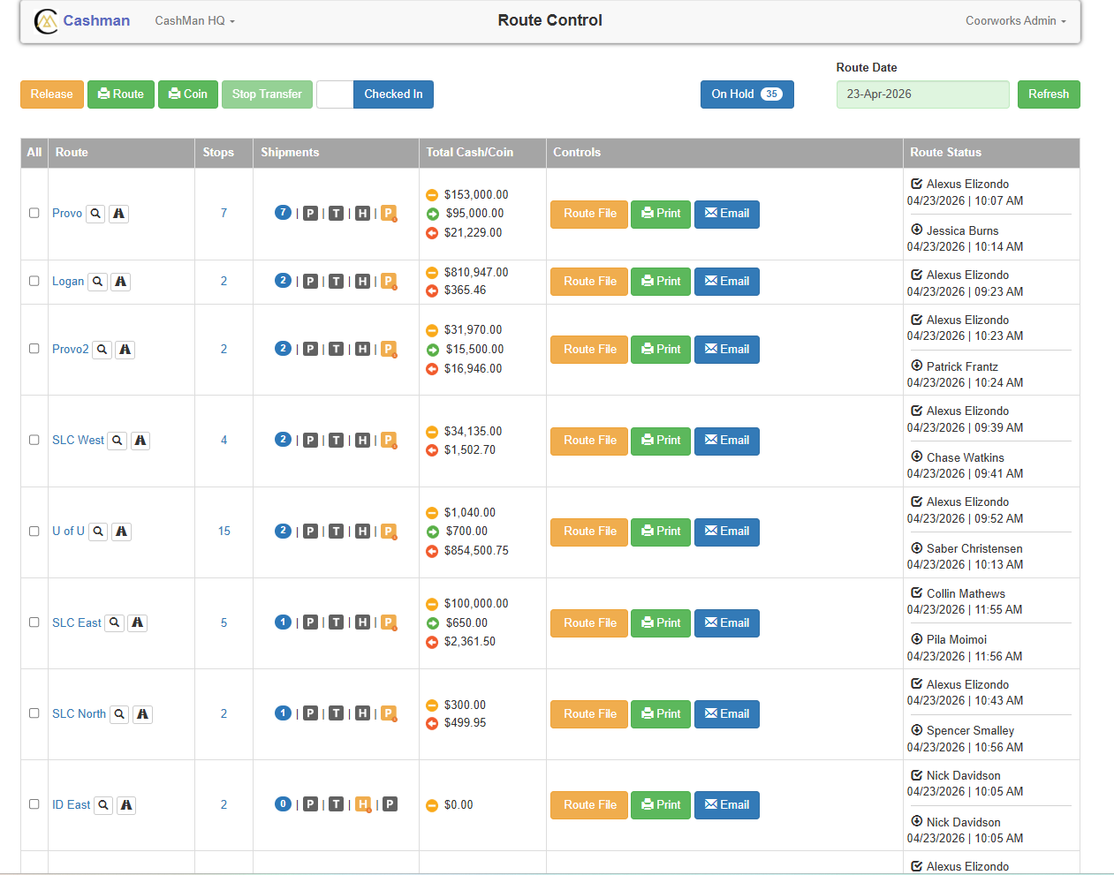
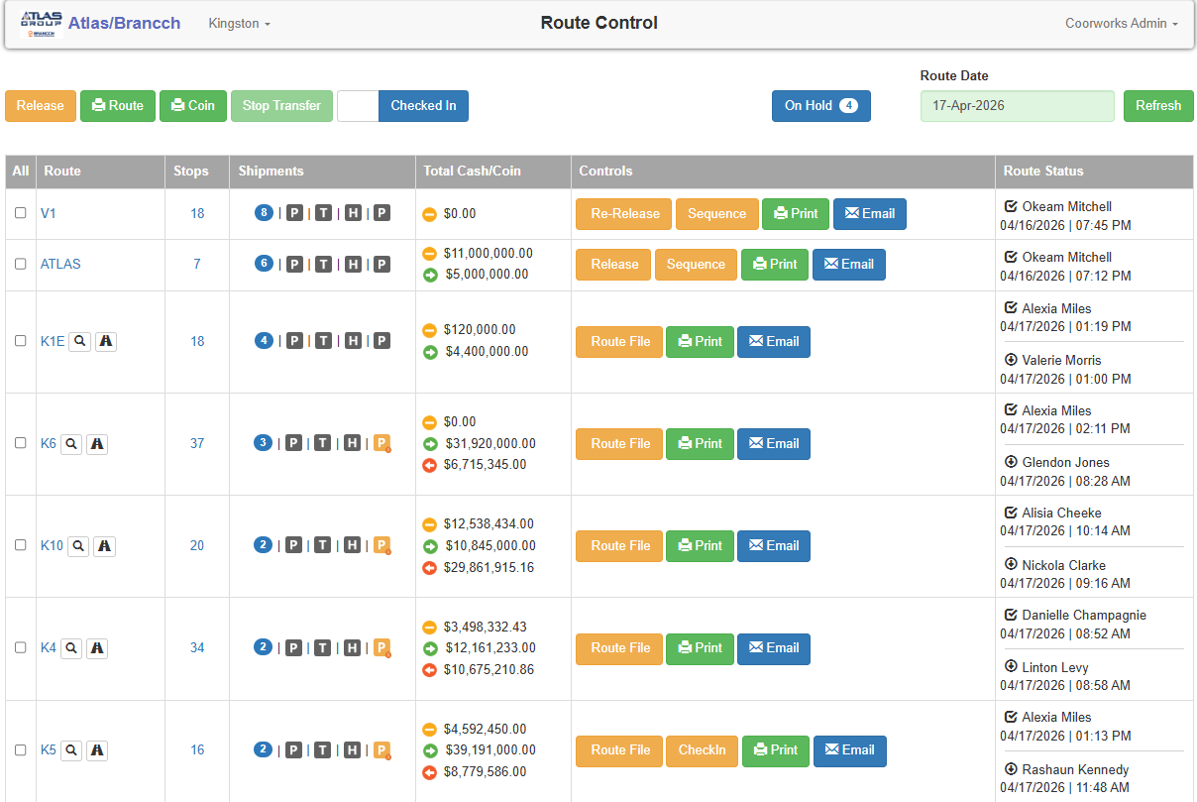
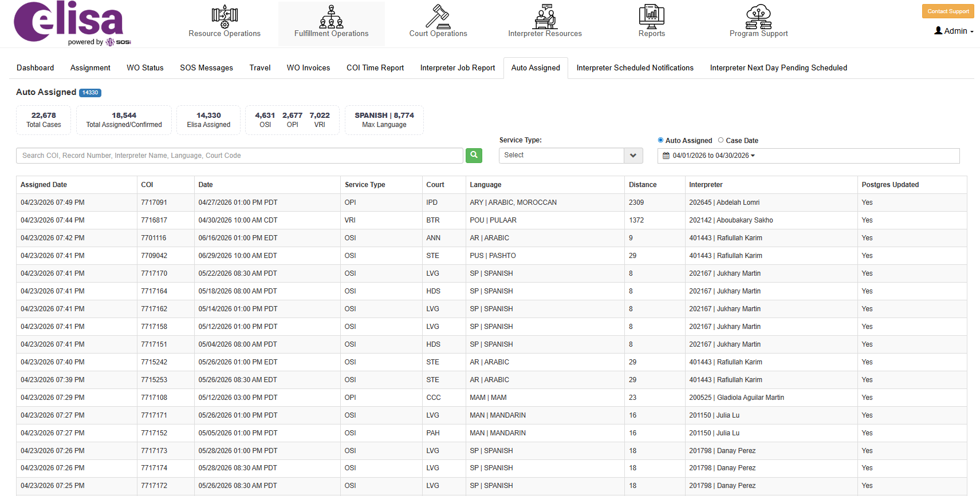
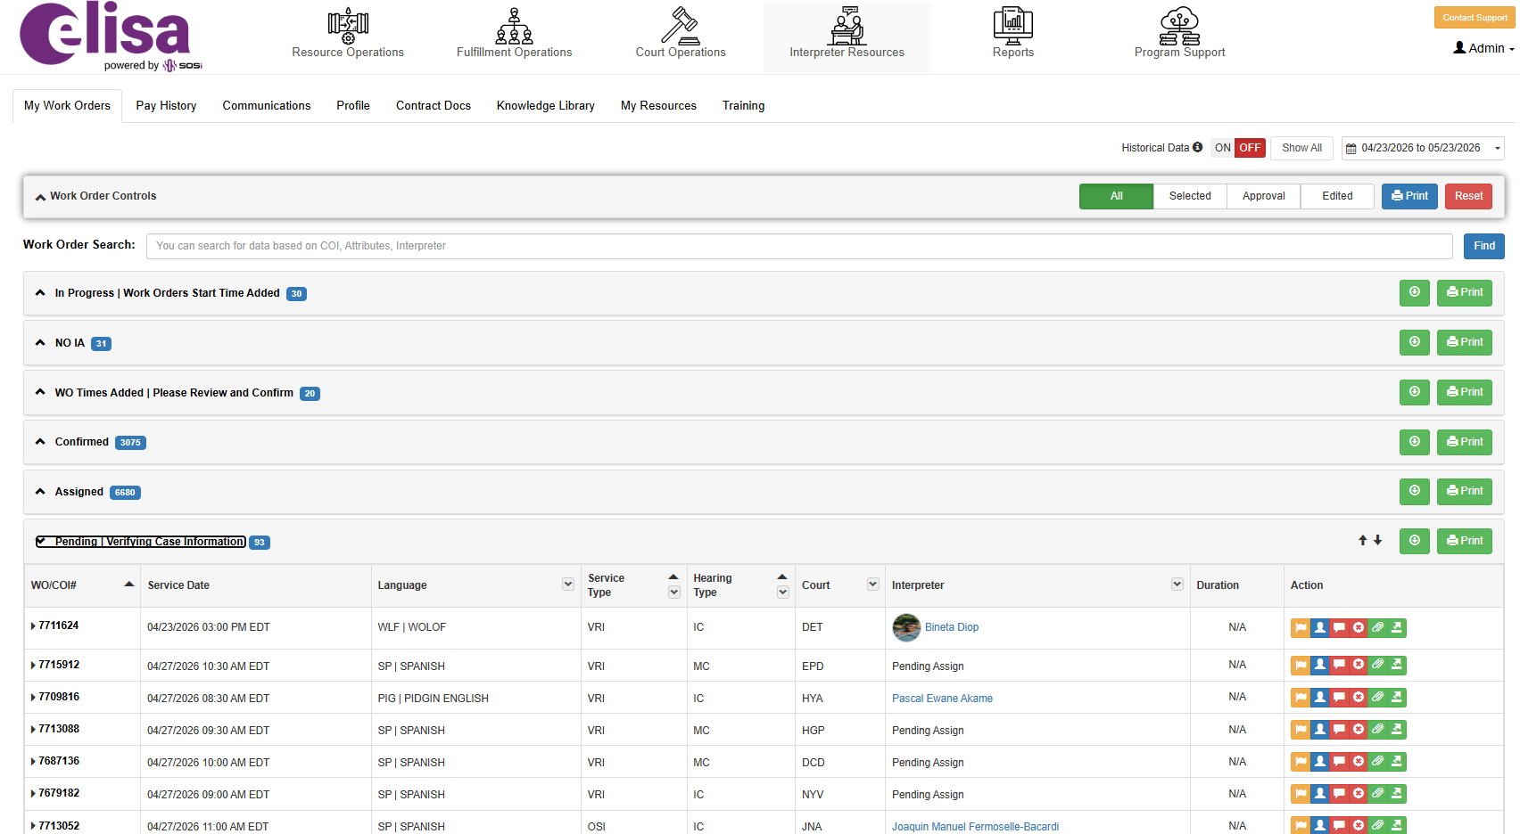
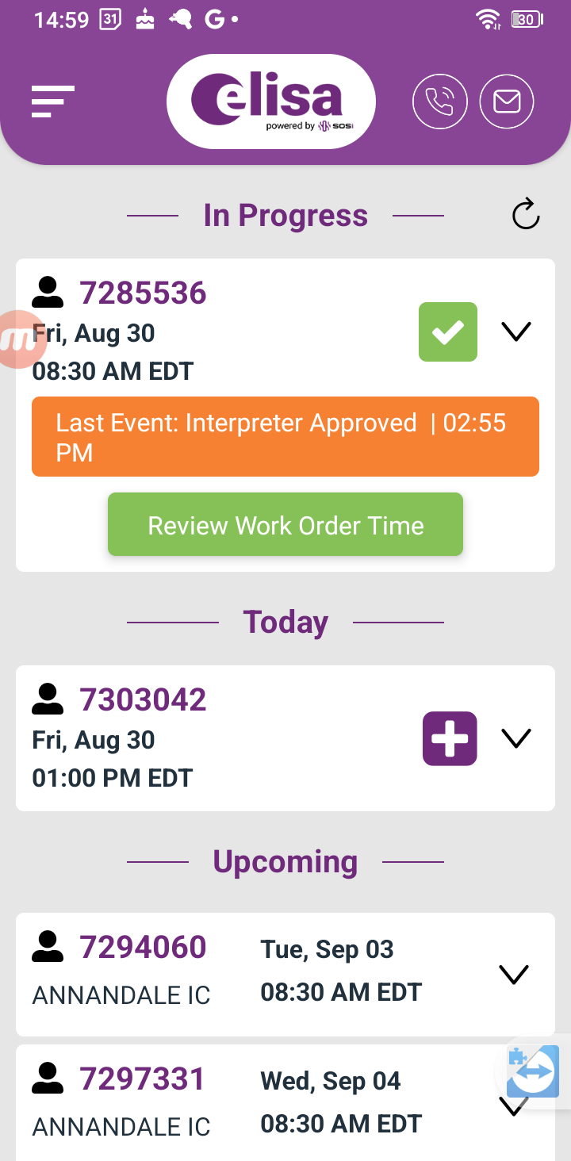
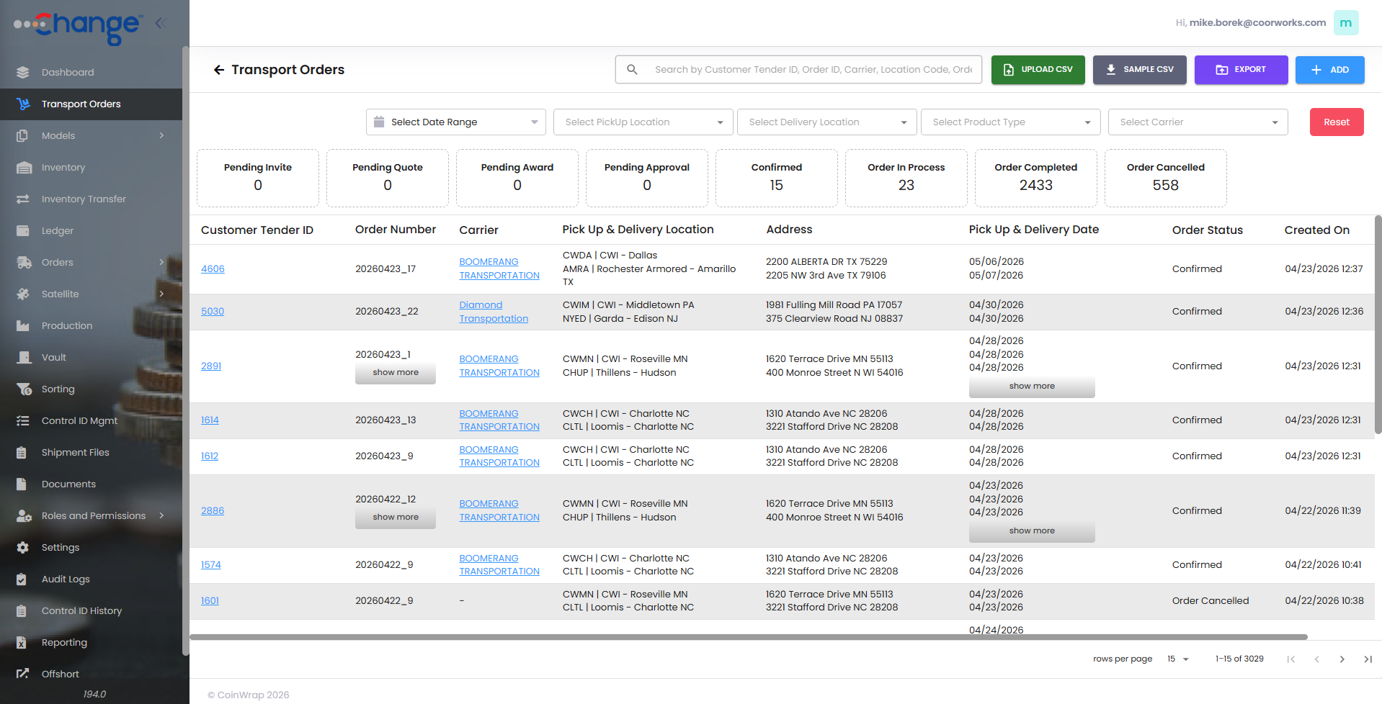
IMAGE COLLECTION (not for site layout – just storage)

